Slide 1
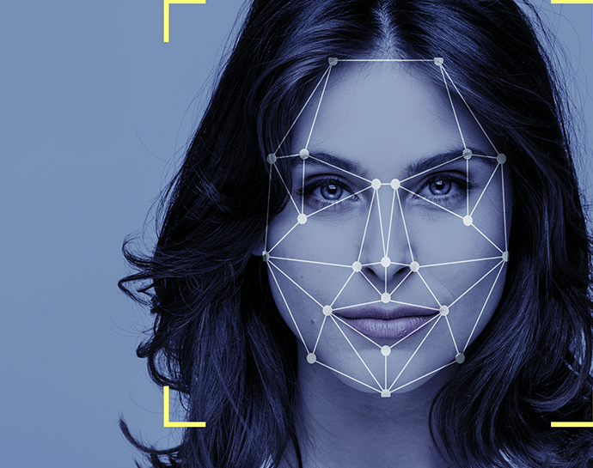
AttendanceEye A Computer Vision Attendance System
By:
Mohsin Ali Mirza – 20k-0353
Waleed Gul – 20k-0259
Mehwish Sameer- 20k - 1085

Slide 2
Acknowledgement
Dr Muhammad Waqas (Supervisor)
Dr Muhammad Rafi (Co-Supervisor)

Slide 3






Table Of Contents
Face Recognition
Multiple Camera Integration
Results
Database Connectivity
Batch Inference - FYP 2

Slide 4
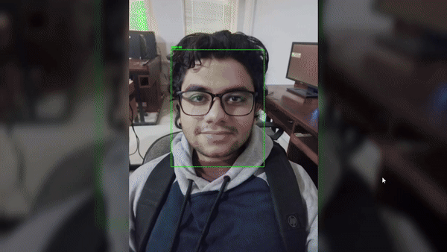
Face Recognition - With Yolov8 - Photos

Slide 5
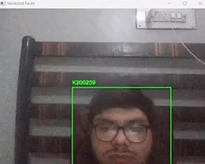
Face Recognition - With Yolov8 – Real Time

Slide 6
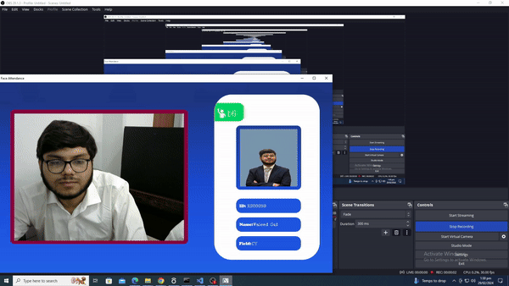
User Interface

Slide 7
Results – Confusion Matrix
Model | Actual Person | Not Actual Person
Algorithm Predicts Person | Algorithm correctly identifies a Person in Database | Algorithm incorrectly identifies the Person with someone else in Database
Algorithm Does Not Detect Person | Algorithm fails to identify a Person who is present in the Database | Algorithm correctly does not identify a Person where there is none in Database
Model | Actual Person | Not Actual Person
Algorithm Detects Person | TP | FP
Algorithm Does Not Detect Person | FN | TN

Slide 8
Results – Confusion Matrix
FR With Yolo | Actual Person | Not Actual Person
Algorithm Predicts Person | 2 (TP) | 1 (FP)
Algorithm Does Not Detect Person | 1 (FN) | 5 (TN)
FR Without Yolo | Actual Person | Not Actual Person
Algorithm Predicts Person | 2 (TP) | 3 (FP)
Algorithm Does Not Detect Person | 1 (FN) | 3 (TN)

Slide 9
Results – Confusion Matrix
FR With Yolo | Actual Person | Not Actual Person
Algorithm Predicts Person | 2 (TP) | 1 (FP)
Algorithm Does Not Detect Person | 1 (FN) | 5 (TN)
Deepface Without Yolo | Actual Person | Not Actual Person
Algorithm Predicts Person | 1 (TP) | 0 (FP)
Algorithm Does Not Detect Person | 5 (FN) | 3 (TN)
Deepface With Yolo | Actual Person | Not Actual Person
Algorithm Predicts Person | 1 (TP) | 1 (FP)
Algorithm Does Not Detect Person | 4 (FN) | 3 (TN)

Slide 10
Results – Accuracy
Model | Accuracy | Precision | Recall | F1-Score
FR With Yolo | 0.77777 | 0.6333333 | 0.699999 | 0.666666
FR Without Yolo | 0.77777 | 0.55 | 0.444 | 0.48
Deepface Without Yolo | 0.6 | 0.59 | 0.55 | 0.57
Deepface With Yolo | 0.58 | 0.56 | 0.38 | 0.42

Slide 11
Results - Inference Time
Model | Best Time | Average Time | Worst Time
FR With Yolo | 0.11 | 0.42122 | 0.6
FR Without Yolo | 7.4 | 10.24 | 19.4
Deepface Without Yolo | 2.05 | 2.89 | 3.31
Deepface With Yolo | 9.2 | 19.0 | 21.5

Slide 12
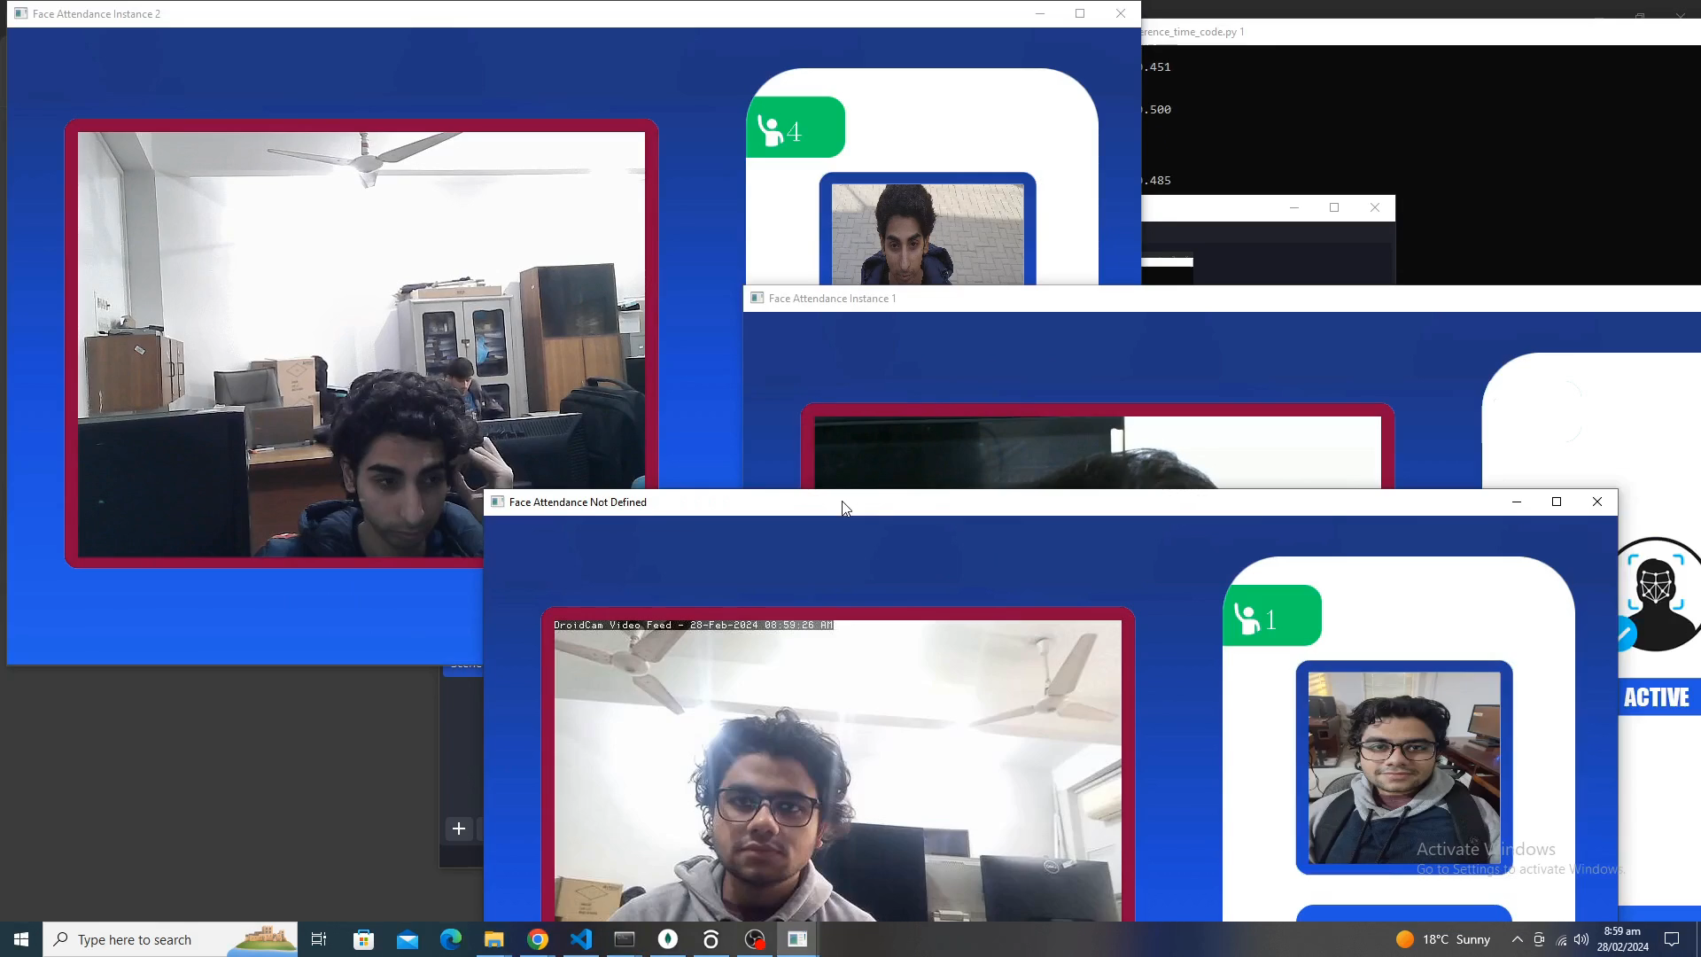
Multiple Camera Inference

Slide 13
Results - Multiple Camera Inference
Try | Face Recognition |  | Database | Marked
 | Best | Worst | Average | Best | Worst
1st | 0.34 | 0.38 | 2.8 | 0.07 | 0.38
2nd | 0.315 | 0.33 | 3.121 | 0.31 | 0.36
3rd | 0.317 | 0.346 | 3.786 | 0.07 | 0.32
Average | 0.324 | 0.352 | 3.24 | 0.15 | 0.35

Slide 14
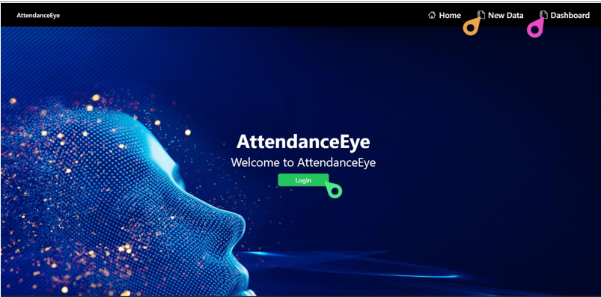
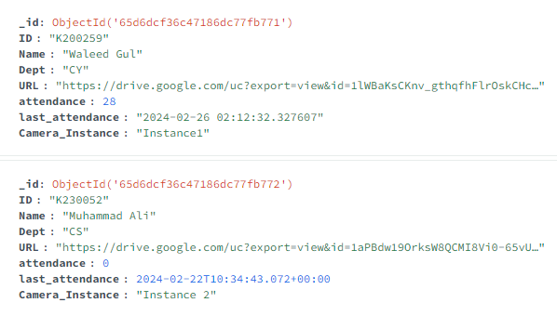
Frontend & Database Connection
Database
Frontend

Slide 15
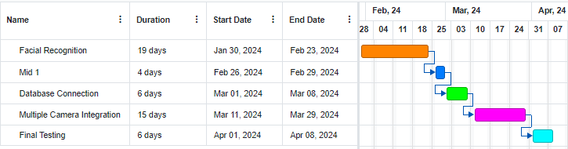
Timeline – FYP 2 - Old

Slide 16
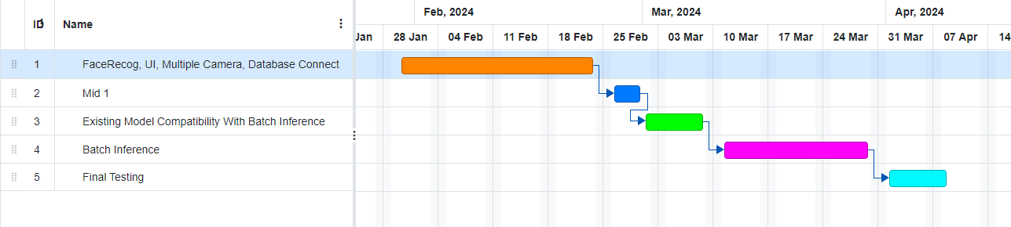
Timeline – FYP 2 - New

Slide 17
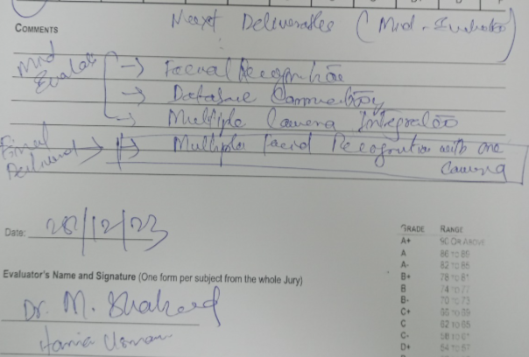
FYP – 2 Final Deliverable – Batch Inference

Slide 18

Any Questions?

Slide 19


Slide 20
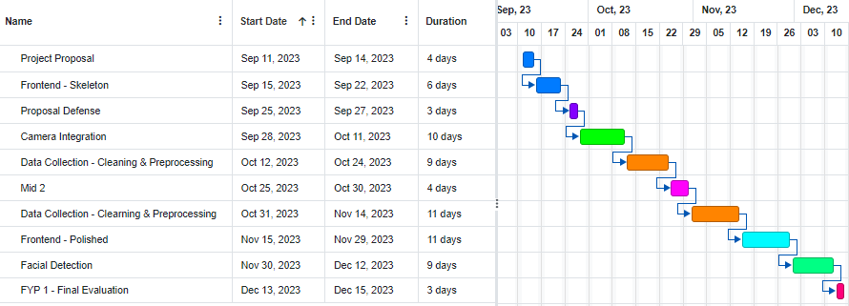
Timeline – FYP 1

